Slide 1

Data Science Tools

Slide 2
Objectives
Categories of Data science tools
Open source tools for Data science
Commercial tool for Data science
Cloud based tools for Data science
Data Science Tools

Slide 3
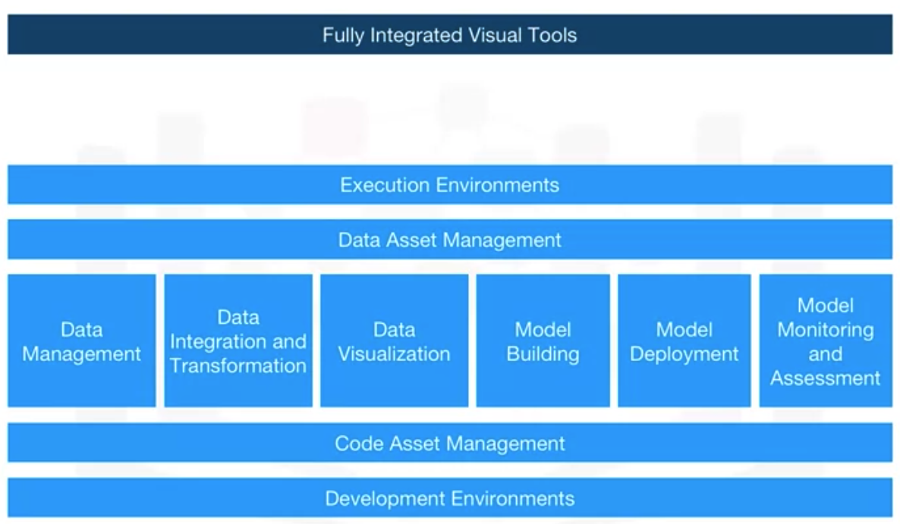
Categories of Data science tools
Data Science Tools

Slide 4
Categories of Data science tools
Data Management is the process of persisting and retrieving data.
Data Integration and Transformation, often referred to as Extract, Transform, and Load, or “ETL,” is the process of retrieving data from remote data management systems. Transforming data and loading it into a local data management system is also part of Data Integration and Transformation.
Data visualization is part of an initial data exploration process, as well as being part of a final deliverable.
Model Building is the process of creating a machine learning or deep learning model using an appropriate algorithm with a lot of data.
Data Science Tools

Slide 5
Categories of Data science tools
Model deployment makes such a machine learning or deep learning model available to third-party applications.
Model monitoring and assessment ensures continuous performance quality checks on the deployed models.
Code asset management uses versioning and other collaborative features to facilitate teamwork.
Data asset management brings the same versioning and collaborative components to data. Data asset management also supports replication, backup, and access right management.
Data Science Tools

Slide 6
Categories of Data science tools
Development environments, commonly known as Integrated Development Environments, or “IDEs”, are tools that help the data scientist to implement, execute, test, and deploy their work.
Execution environments are tools where data preprocessing, model training, and deployment take place.
Finally, there is fully integrated, visual tooling available that covers all the previous tooling components, either partially or completely.
Data Science Tools

Slide 7
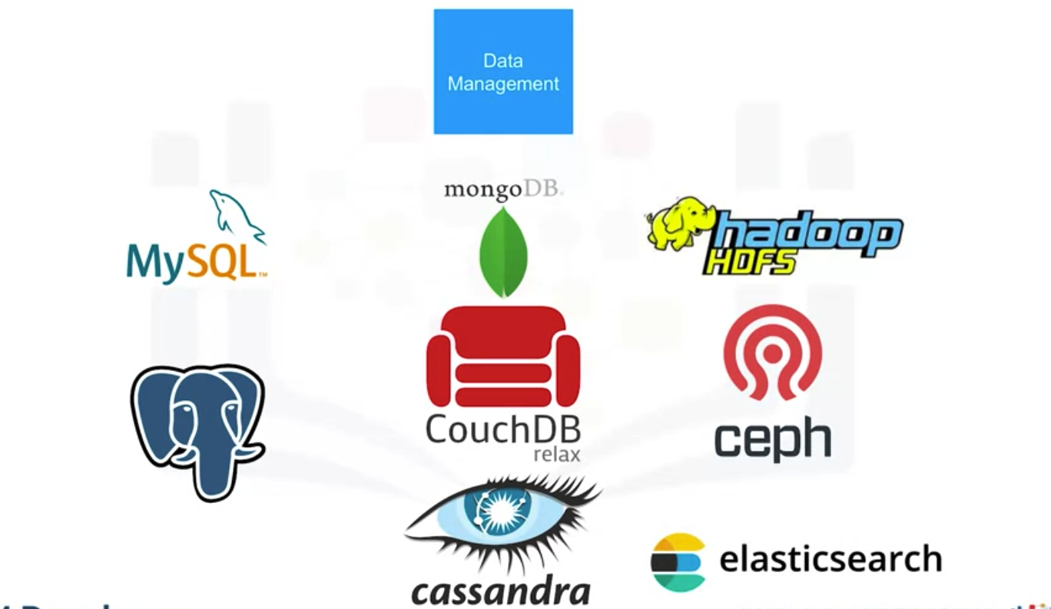
Open Source Tools for Data Science
Data Science Tools

Slide 8
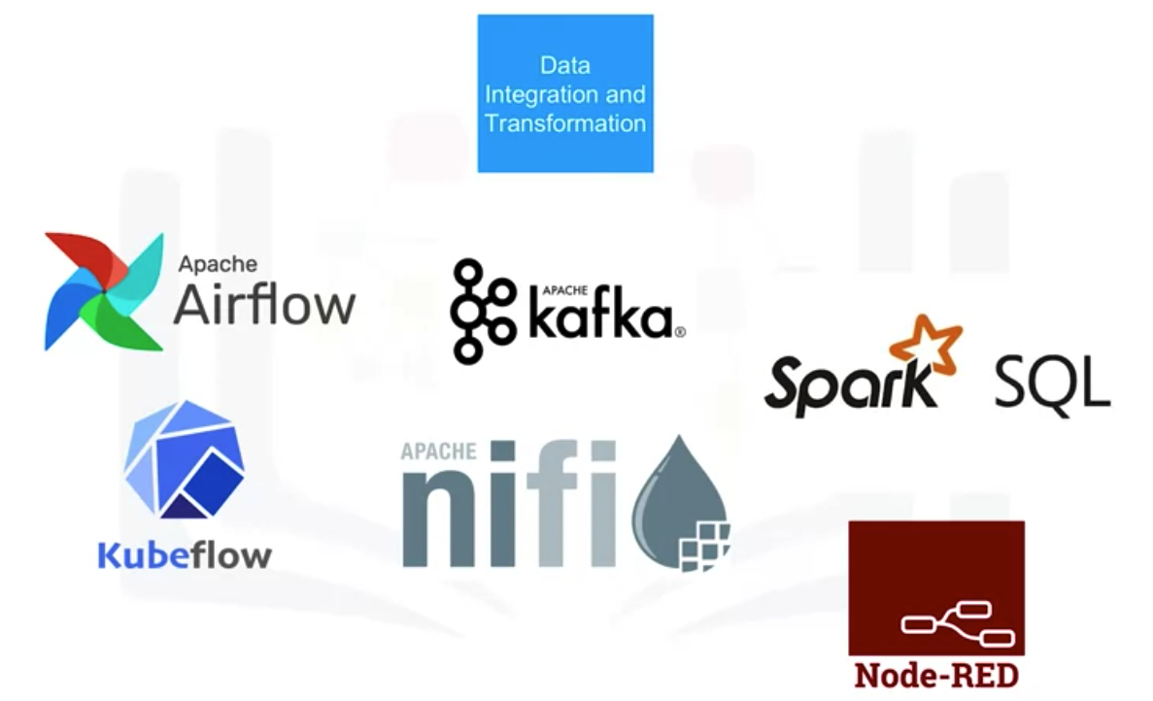
Open Source Tools for Data Science
Data Science Tools

Slide 9
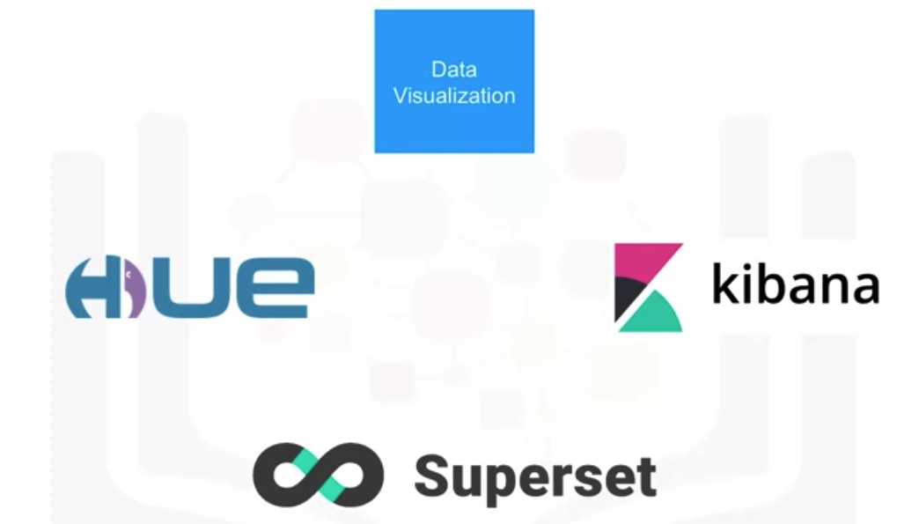
Open Source Tools for Data Science
Data Science Tools

Slide 10
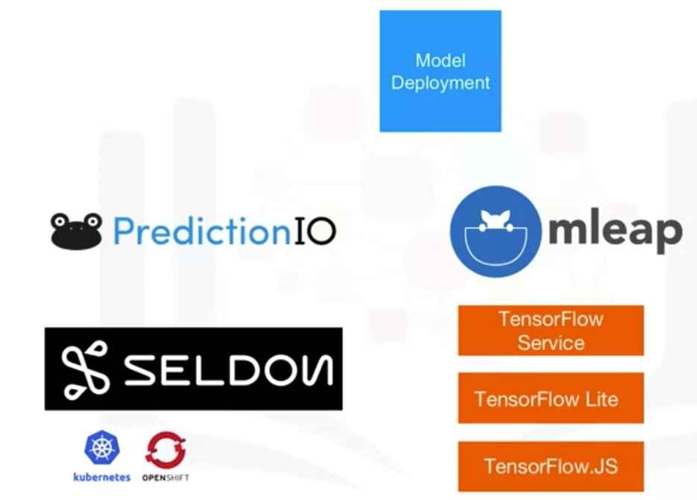
Open Source Tools for Data Science
Data Science Tools

Slide 11
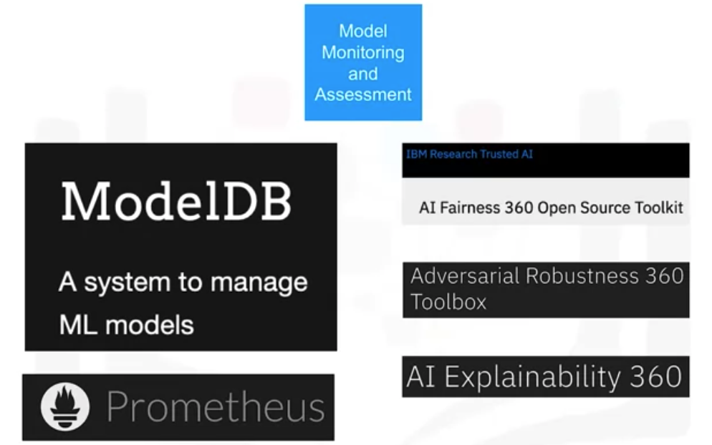
Open Source Tools for Data Science
Data Science Tools

Slide 12
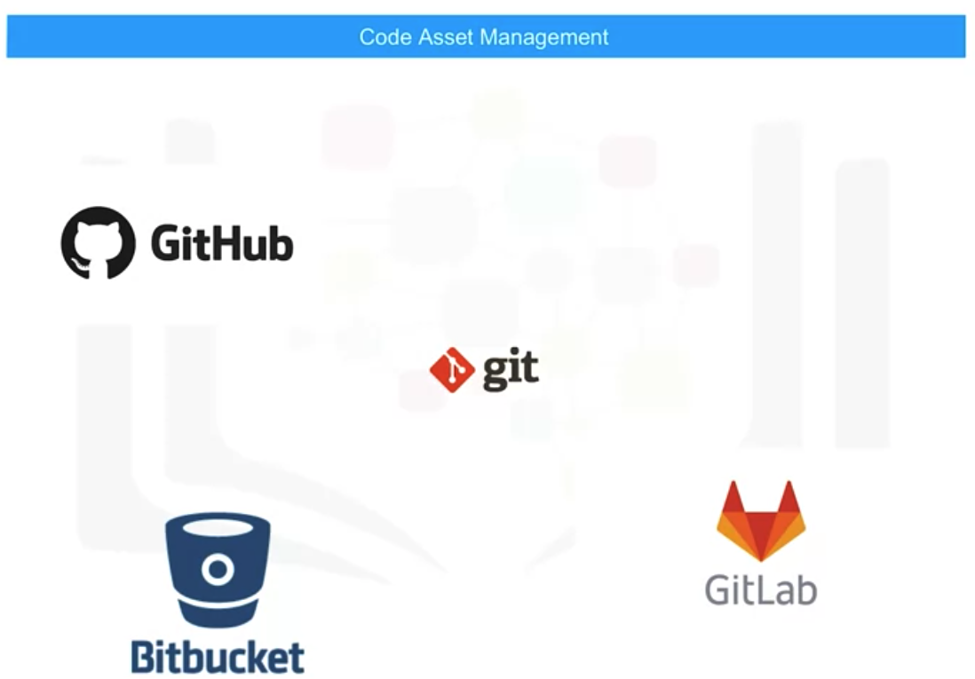
Open Source Tools for Data Science
Data Science Tools

Slide 13
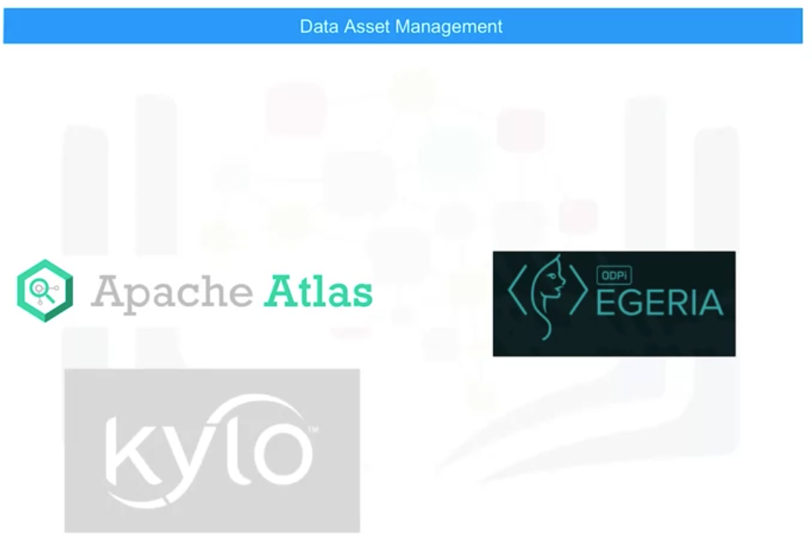
Open Source Tools for Data Science
Data Science Tools

Slide 14
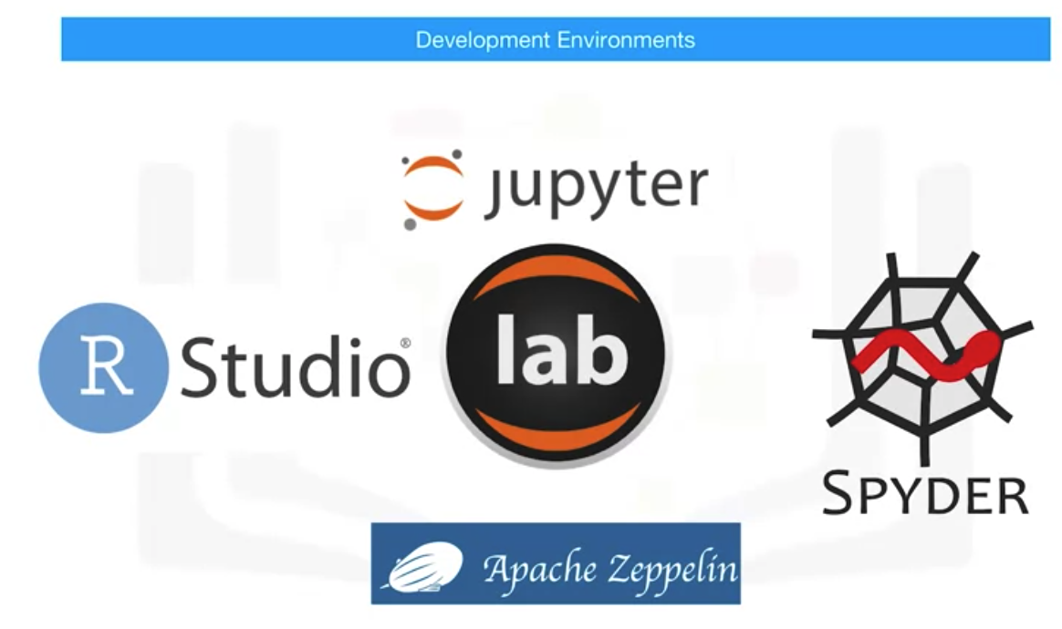
Open Source Tools for Data Science
Data Science Tools

Slide 15
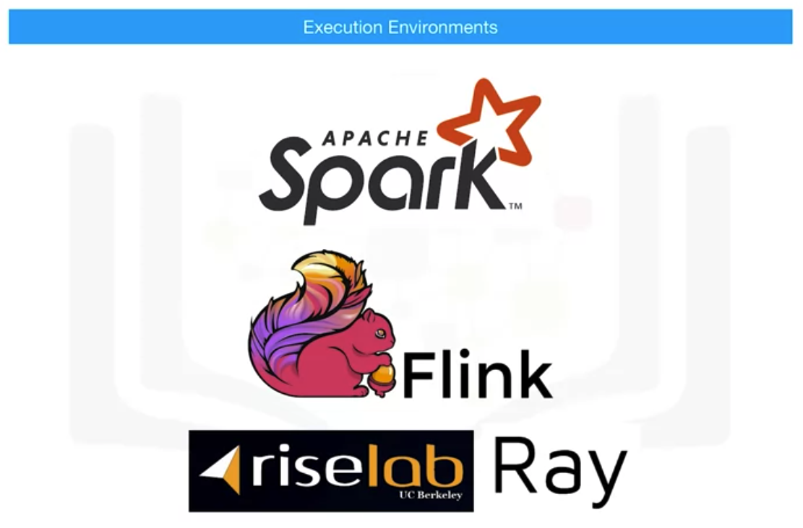
Open Source Tools for Data Science
Data Science Tools

Slide 16
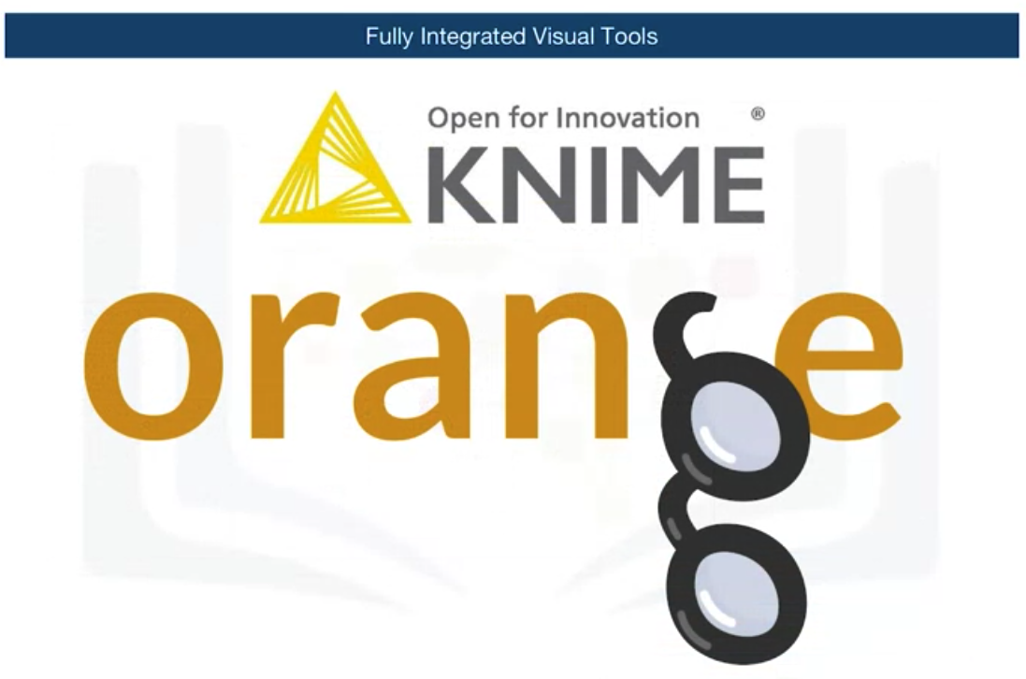
Open Source Tools for Data Science
Data Science Tools

Slide 17
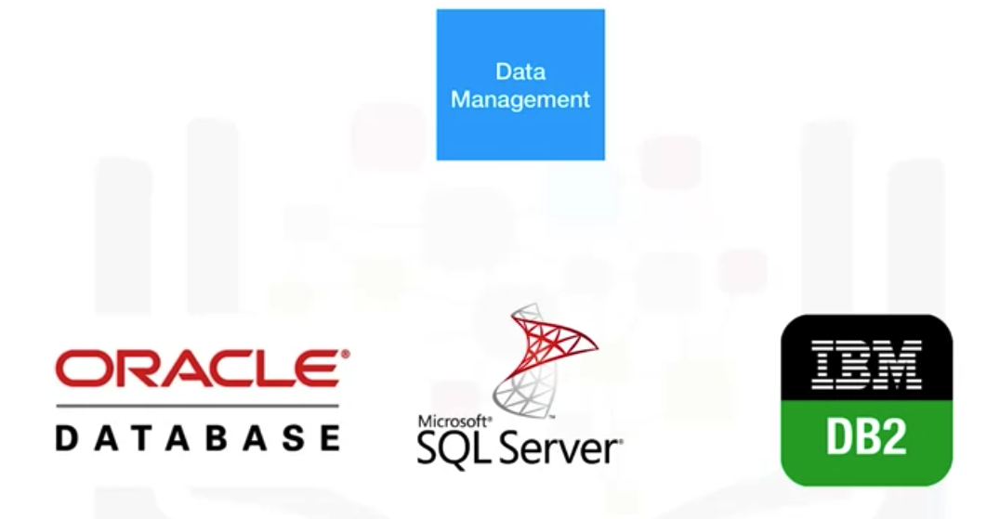
Commercial Tools for Data Science
Data Science Tools

Slide 18
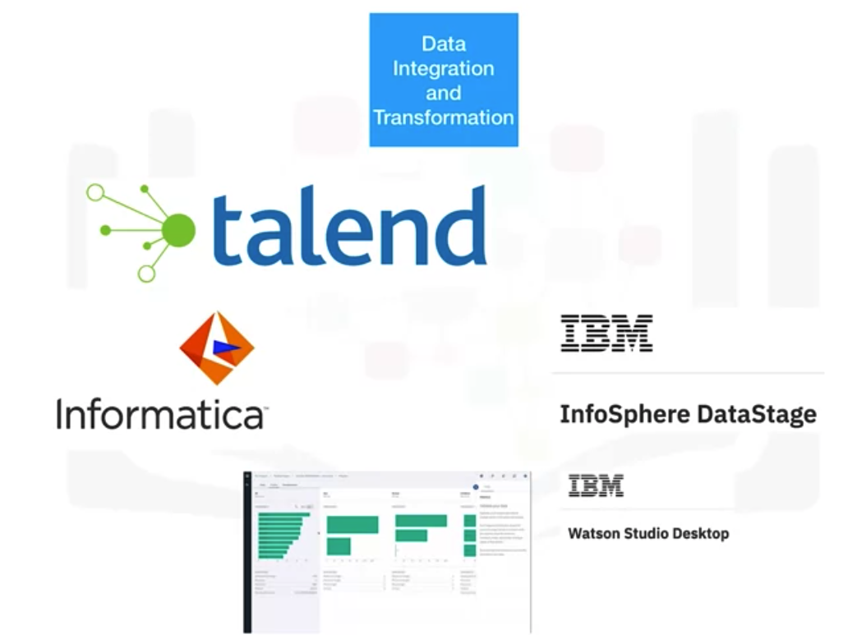
Commercial Tools for Data Science
Data Science Tools

Slide 19
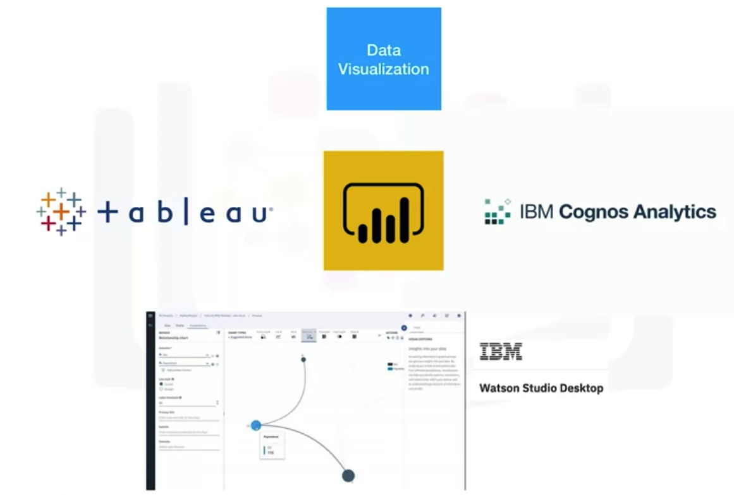
Commercial Tools for Data Science
Data Science Tools

Slide 20
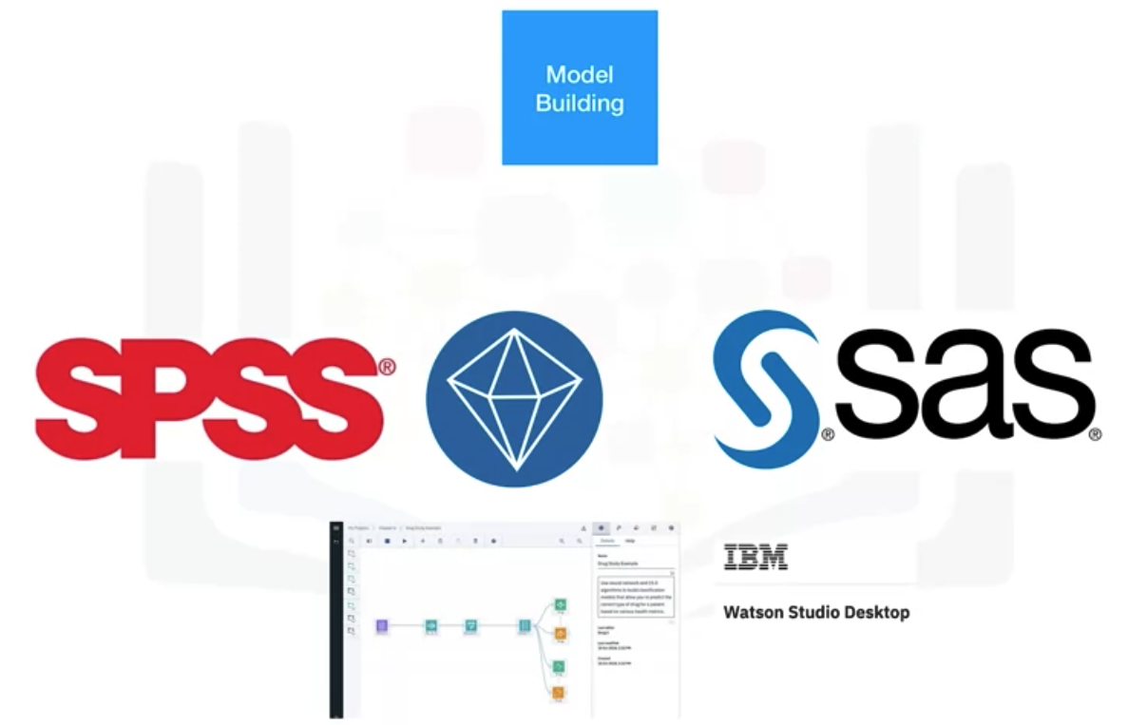
Commercial Tools for Data Science
Data Science Tools

Slide 21
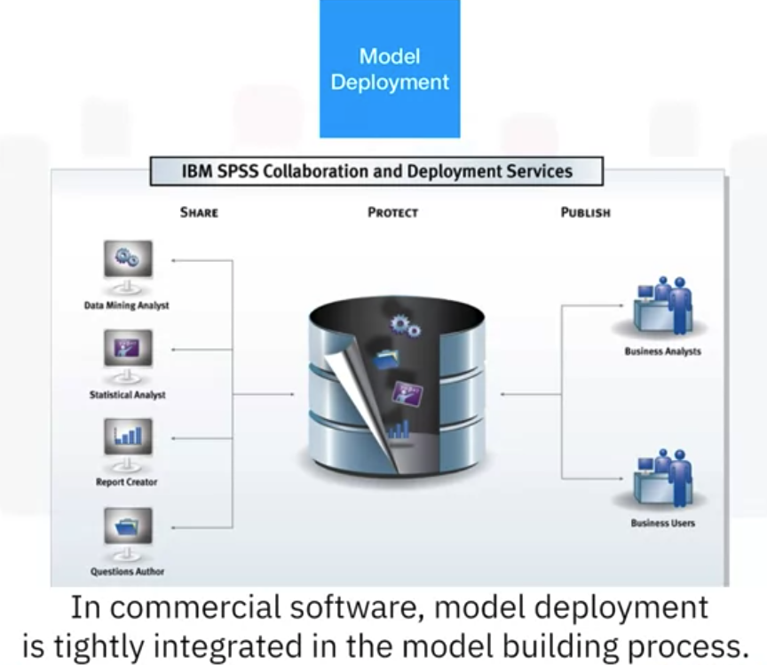
Commercial Tools for Data Science
Data Science Tools

Slide 22
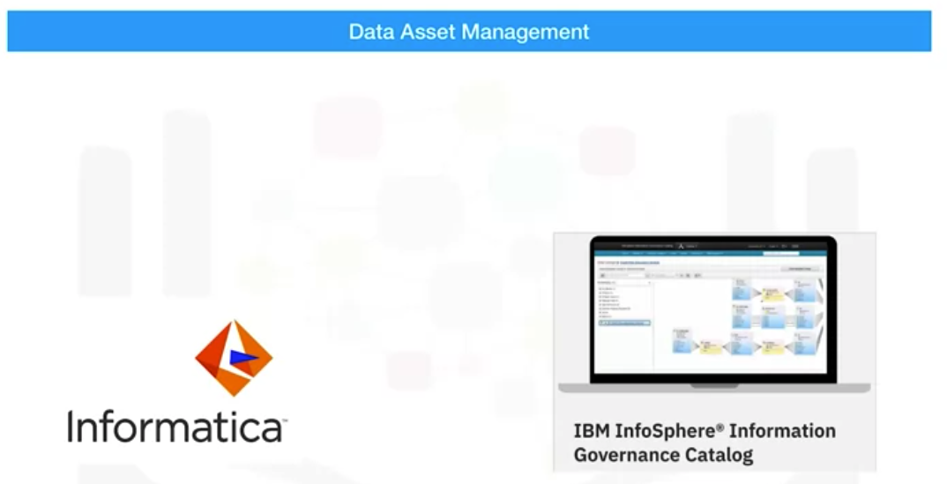
Commercial Tools for Data Science
Data Science Tools

Slide 23
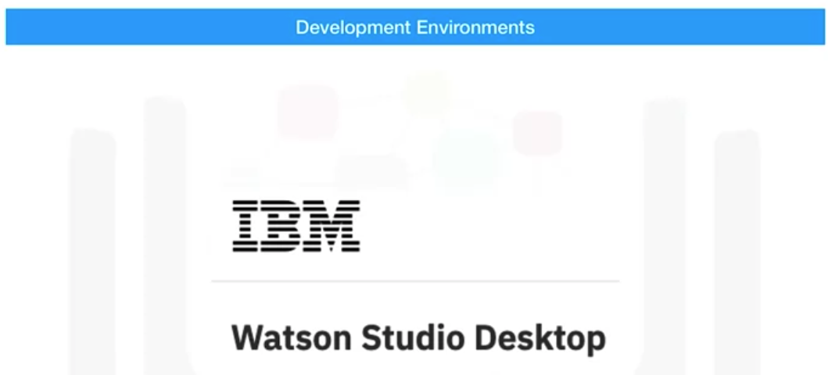
Commercial Tools for Data Science
Data Science Tools

Slide 24
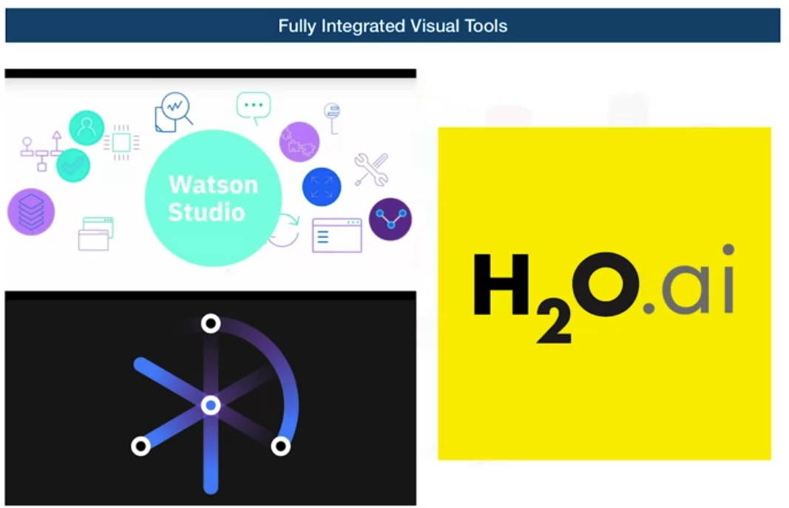
Commercial Tools for Data Science
Data Science Tools

Slide 25
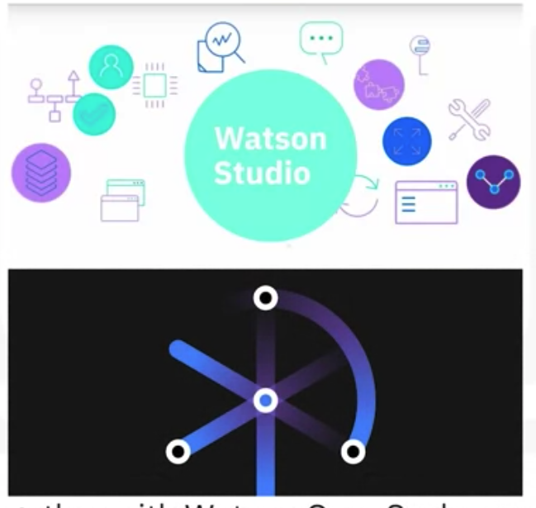
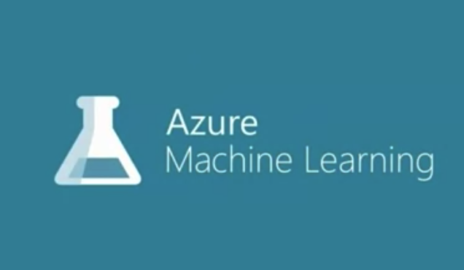
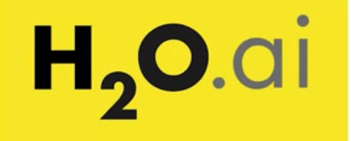
Cloud based Tools for Data Science
Data Science Tools

Slide 26
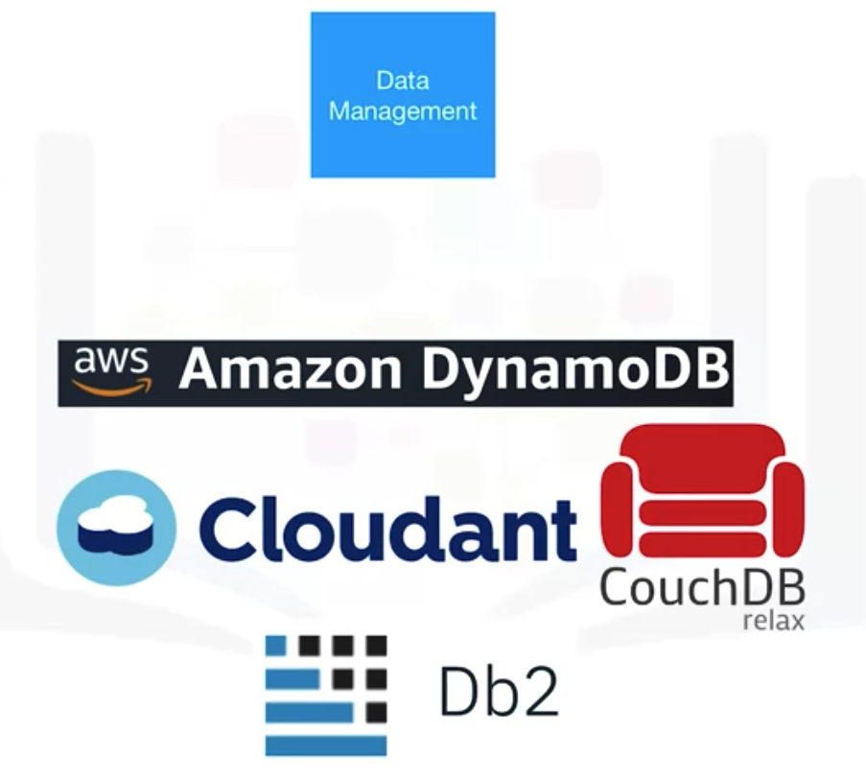
Cloud based Tools for Data Science
Data Science Tools

Slide 27
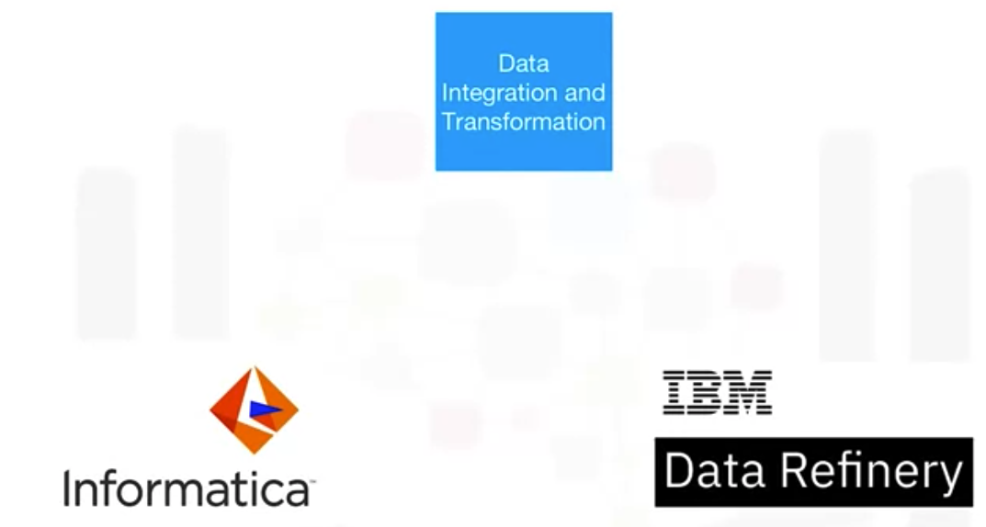
Cloud based Tools for Data Science
Data Science Tools

Slide 28
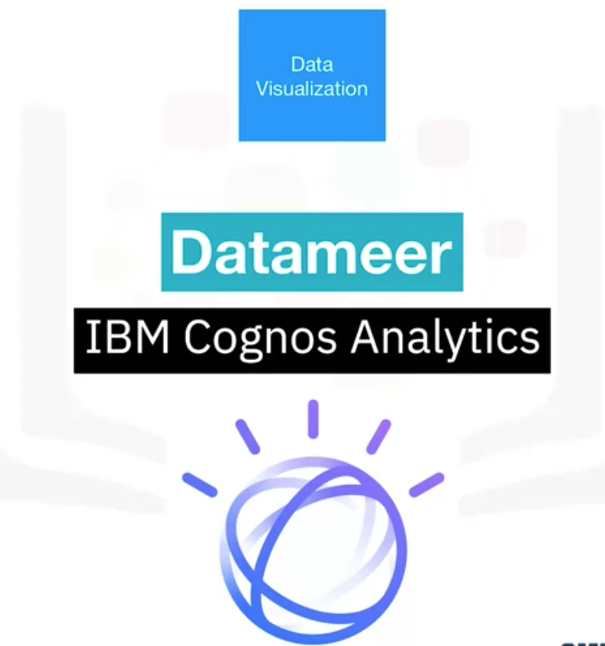
Cloud based Tools for Data Science
Data Science Tools

Slide 29
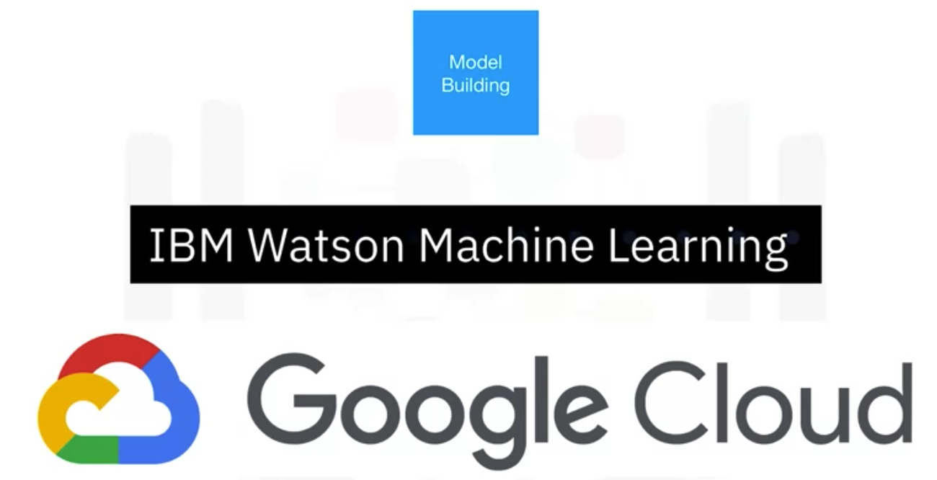
Cloud based Tools for Data Science
Data Science Tools

Slide 30
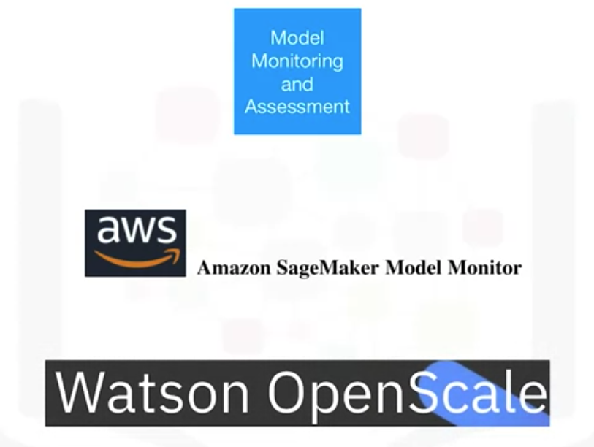
Cloud based Tools for Data Science
Data Science Tools

Slide 31
Summary
Understand categories of Data science tools
Understand open source tools for Data science
Understand commercial tool for Data science
Understand cloud based tools for Data science
Data Science Tools

Slide 32
Q & A
Data Science Tools

